Slide 1
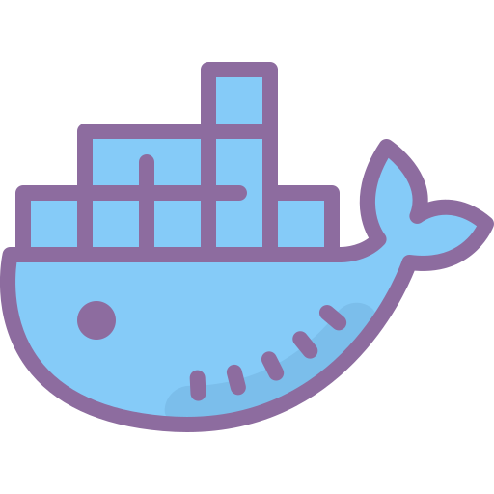
Introduction to Docker
By Abhishek Raj

Slide 2

What is Docker?
Docker is an open-source platform that allows you to develop, deploy, and run applications inside containers. A container is a lightweight, standalone, and executable package that includes everything needed to run a piece of software, including the code, runtime, libraries, and system tools. Docker provides a consistent and efficient way to package, distribute, and manage applications, regardless of the environment they run in. It's like a virtual machine, but much more efficient and faster.

Slide 3
Why use Docker?
Portability
Isolation
Efficiency
Scaling
Version Control

Slide 4
Key Docker Terminology
Containers: Containers are instances of Docker images. They are isolated and contain all the necessary components to run an application, making it easy to package and deploy software.
Images: Docker images are read-only templates that define the application and its dependencies. Images are used to create containers.
Dockerfile: A Dockerfile is a text file that contains instructions for building a Docker image. It specifies the base image, adds application code, sets environment variables, and more.
Registry: A Docker registry is a repository for Docker images. Docker Hub is a popular public registry, but you can also set up your private registry for storing and sharing custom images.

Slide 5
Dockerfile
A Dockerfile is a plain text configuration file used to specify the instructions and steps required to build a Docker container image. It serves as a blueprint for creating containerized applications.

Slide 6
Dockerfile example
# Use an official Python runtime as the base image
FROM python:3.8-slim
# Create a directory to hold your application code
WORKDIR /app
# Create a simple "Hello, World!" Python script
RUN echo "print('Hello, World!')" > hello.py
# Define the command to run your script
CMD ["python", "hello.py"]
To build: docker build -t simple-hello-world .
To run: docker run simple-hello-world

Slide 7
Docker compose
Docker Compose is a tool for defining and running multi-container Docker applications. It allows you to define a set of services, their dependencies, and the network configuration in a single file called a docker-compose.yml file.

Slide 8
Docker compose example
version: '3'
services:
webapp:
image: python:3.8-slim
ports:
- "80:80"
volumes:
- ./webapp:/app
command: python -m http.server 80
database:
image: postgres:13
environment:
POSTGRES_PASSWORD: mysecretpassword

Slide 9
Installing docker and docker compose in ubuntu
https://www.digitalocean.com/community/tutorials/how-to-install-and-use-docker-on-ubuntu-20-04
https://www.digitalocean.com/community/tutorials/how-to-install-and-use-docker-compose-on-ubuntu-20-04

Slide 10
Docker Hands on
https://github.com/abhic137/Docker-Basics

Slide 11

Link to the Slides
https://docs.google.com/presentation/d/1G0adoiNJAPvSxiomE7YiE4gzeP9iLYtA0_JQghdYcKg/edit?usp=sharing

